Slide 1
Introduction to data processing with Hadoop
Zbigniew Baranowski
IT-DB

Slide 2
What you will learn in this session?
Hadoop architecture
Overview of main Hadoop components
Methodologies for data storing
Methodologies for data accessing and processing
Limitations of Hadoop
Some best practices for building a system based on Hadoop

Slide 3
Practice yourself!
Example scripts and code available
https://gitlab.cern.ch/db/hadoop-intro
$ git clone https://:@gitlab.cern.ch:8443/db/hadoop-intro.git
How to get Hadoop environment quickly?
For playground use Cloudera Quickstart VM
For serious development file a ticket to Hadoop Service (after the training)
Cloudera Quickstart
Image available in CERN’s Openstack : CentOS 6 - Cloudera Quickstart
Get it from Cloudera:
https://www.cloudera.com/downloads/quickstart_vms/5-8.html

Slide 4
Basics of Hadoop

Slide 5

What is Hadoop?
Started at Yahoo in 2006 based on Google File System and MapReduce from 2003-2004
A framework for large scale data processing
Open source
Written in Java
To be run on a commodity hardware
3Vs of big data:
Data Volume (Terabytes, Zettabytes)
Data Variety (Structured, Unstructured)
Data Velocity ( Stream processing)

Slide 6
What is Hadoop? The concept
Shared nothing – scales out!
Split and distribute data across many machines (sharding)
Fault tolerant - multiple copies ( typically 3)
Distribute data processing
sequential data scanning
profit from data locality => high throughput between storage and CPU and Memory
Interconnect network
CPU
CPU
CPU
CPU
CPU
CPU
MEMORY
MEMORY
MEMORY
MEMORY
MEMORY
MEMORY
Disks
Disks
Disks
Disks
Disks
Disks
Node 1
Node 2
Node 3
Node 4
Node 5
Node X

Slide 7












Hadoop - set of independently deployable components
Sqoop
Data exchange with RDBMS
Pig
Scripting
Oozie
Workflow manager
Hive
SQL
Spark
Large scale data proceesing
Impala
Low latency SQL
HBase
NoSql columnar store
Solr
Full-text search, real-time indexing
Kafka
Data streaming
Zookeeper
Coordination of distributed systems
Hue
Web UI for Hadoop
Flume
Data collector
MapReduce
YARN
Cluster resource manager
HDFS
Hadoop Distributed File System

Slide 8
Hadoop cluster architecture
Master and slaves architecture
Interconnect network
HDFS NameNode
YARN ResourceManager
Hive metastore
Various component agents and demons
Various component agents and demons
Various component agents and demons
Various component agents and masters
Various component agents and masters
Various component agents and demons
YARN Node Manager
YARN Node Manager
YARN Node Manager
YARN Node Manager
YARN Node Manager
YARN Node Manager
HDFS DataNode
HDFS DataNode
HDFS DataNode
HDFS DataNode
HDFS DataNode
HDFS DataNode
Node 1
Node 2
Node 3
Node 4
Node 5
Node X

Slide 9
What to use the Hadoop for?
For Big Data!
Strong for a batch processing at scale
write once – read many
ad-hoc
data exploration, reporting, statistics, aggregations, correlation, machine learning
Typical use cases
Building data warehouses for structured data
Storing and processing systems’ logs

Slide 10
What to not use the Hadoop for?
Not strong for Online Transaction Processing system
No multi-record transactions
No locks
No data updates (only appends and overwrites)
Typically response time in minutes rather milliseconds
Not optimal for systems with relational data
Interactive applications
Complex registries
Etc.

Slide 11

What is available at CERN?
https://cern.service-now.com/service-portal/function.do?name=Hadoop-Components
Sqoop
Data exchange with RDBMS
Pig
Scripting
Oozie
Workflow manager
Hive
SQL
Spark
Large scale data proceesing
HBase
NoSql columnar store
Impala
SQL
Solr
Full-text search, real-time indexing
Kafka
Data streaming
Hue
Web UI for Hadoop
Zookeeper
Coordination
Flume
Data collector
ElasticSearch
Full-text search, real-time indexing
MapReduce
YARN
Cluster resource manager
HDFS
Hadoop Distributed File System

Slide 12
Hadoop service @CERN
Components (as of November 2017)
HDFS, YARN (with Spark and MR), Hive, Impala, HBase, Zookeeper, Hue
4 production clusters (+ 1 for QA and +1 for DEV)
Cluster Name | Configuration | Primary Usage
lxhadoop | 18 nodes (Cores – 288,Mem – 912GB,Storage – 1.29 PB) | Experiment activities
analytix | 36 nodes (Cores – 576,Mem – 2.18TB,Storage – 3.3 PB) | General Purpose
hadalytic | 14 nodes (Cores – 196,Mem – 768GB,Storage – 2.15 PB) | SQL-oriented engines and datawarehouse workloads
nxcals | 20 nodes (Cores 480, Mem - 8 TB, Storage - 5 PB) | Accelerator logging (NXCALS) project dedicated cluster

Slide 13
HDFS and YARN - Core Hadoop components

Slide 14
Hadoop Distributed File Systems (HDFS)
Sqoop
Data exchange with RDBMS
Pig
Scripting
Oozie
Workflow manager
Hive
SQL
Spark
Large scale data proceesing
HBase
NoSql columnar store
Impala
SQL
Solr
Full-text search, real-time indexing
Hue
Web UI for Hadoop
Kafka
Data streaming
ElasticSearch
Full-text search, real-time indexing
Zookeeper
Coordination
Flume
Data collector
MapReduce
YARN
Cluster resource manager
HDFS
Hadoop Distributed File System

Slide 15
HDFS in nutshell
Distributed files system for Hadoop
Fault tolerant -> multiple replicas of data spread across a cluster
Scalable -> design to deliver high throughputs, sacrificing an access latency
Files cannot be modified in place
Permissions on files and folders like in POSIX + additional ACLs can be set
Architecture
NameNode -> maintains and manages file system metadata (in RAM)
DataNodes -> store and manipulate the data (blocks)

Slide 16
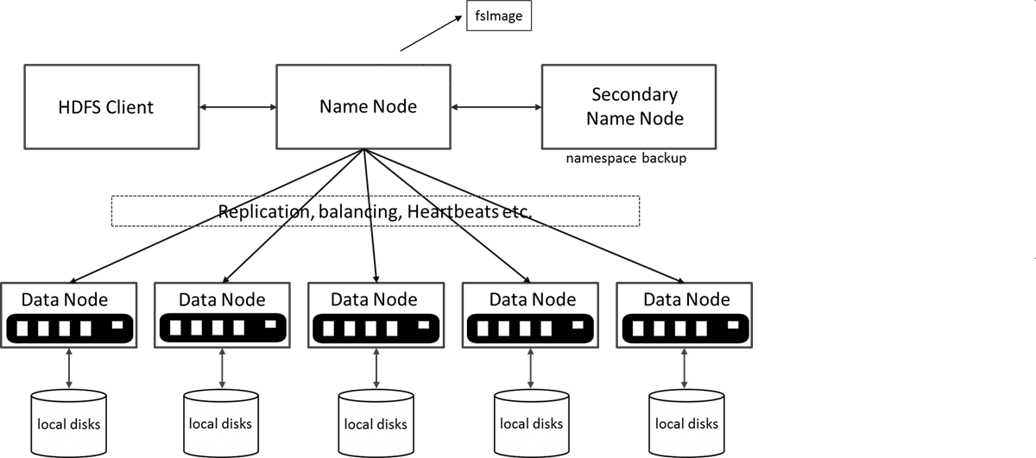
HDFS architecture

Slide 17
How HDFS stores the data
1) File to be stored on HDFS
256MB
256MB
256MB
102MB
1.1GB
256MB
2) Splitting into 256MB
blocks
3) Ask NameNode where to put them
4) Blocks with their replicas (by default 3) are distributed across Data Nodes
256MB
256MB
256MB
256MB
256MB
256MB
256MB
256MB
256MB
256MB
256MB
102MB
256MB
102MB
102MB
DataNode1
DataNode2
DataNode3
DataNode4
Notes:
Interestingly client and NN does not wait till all the replicas of the block are acknowledged, it only ensure that at-least one copy of file is completely on the cluster.
Another fact is that client does not start transmitting data till it has one block with it, i.e. the DFSClient keep buffering data locally till one block of data or the end-of-file is reached.
The above illustration assumes that replication factor of files is set to three. Accordingly if the replication factor is more that or less than three, steps 6-10 would be repeated accordingly. BTW, the minimum replication factor or a file can be 1 and max can be 512. However the default value is three.
Also this illustration is till before Hadoop version 0.23. I still have to look into the federated NN architecture.
While the lease is with a particular client, no other client can write to this file, or delete the file. However it can read the file.
Write to the file can happen only at the end of the file, i.e. only append is allowed. That too is available only on ver 0.20.205 and beyond. The feature was there in earlier versions as well, however was not tested and disabled by default.

Slide 18
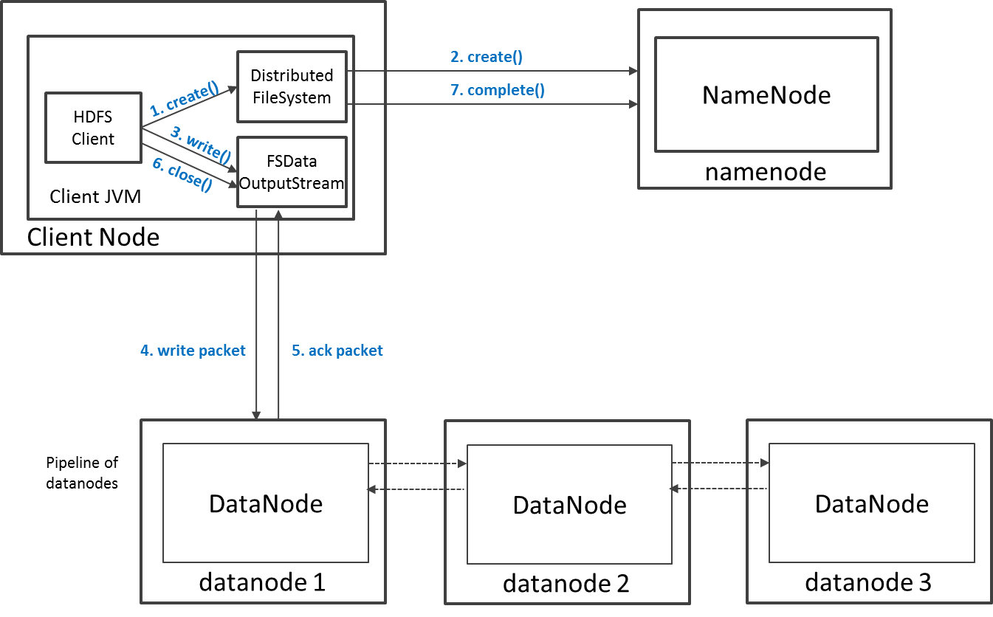
HDFS write operations

Slide 19
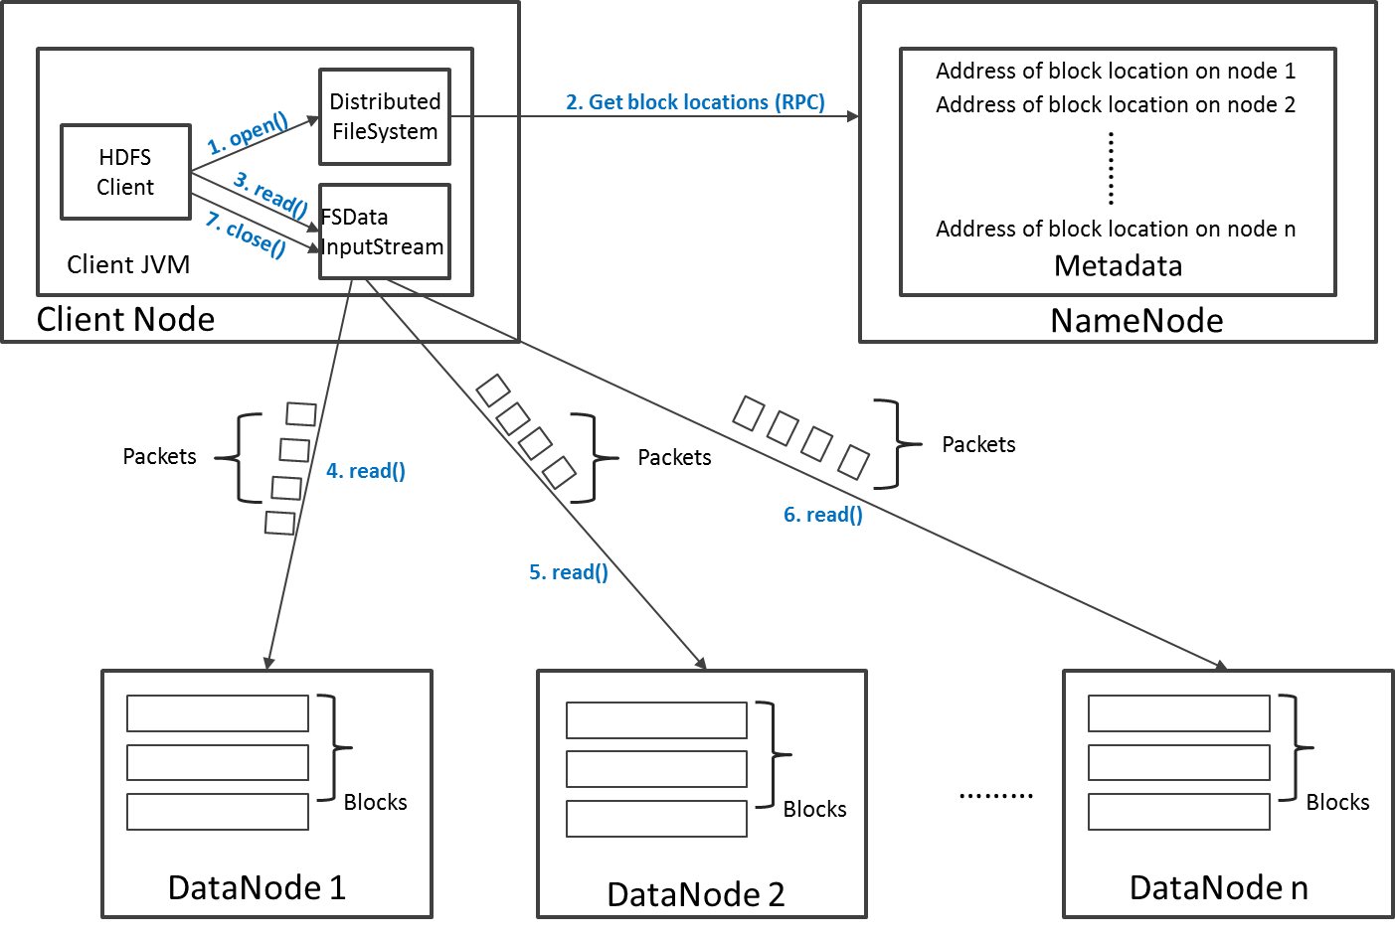
HDFS read operation

Slide 20
Interacting with HDFS
Shell commands (examples)
Can be mounted with Fuse
Programing bindings
Java, Python, C++
HDFS has web UI where its status can be tracked
hdfs dfs –ls #listing home dir
hdfs dfs –ls /user #listing user dir…
hdfs dfs –du –h /user #space used
hdfs dfs –mkdir newdir #creating dir
hdfs dfs –put myfile.csv . #storing a file on HDFS
hdfs dfs –get myfile.csv . #getting a file fr HDFS
More about HDFS: https://indico.cern.ch/event/404527/

Slide 21
YARN – (yet another) Resource manager
Manages computing resources available on the cluster
Memory and CPU cores
Creates the environment for Hadoop applications
Deploys applications(jobs) on the cluster
Coordination of application code distribution
Starting containers for application code executors on each of cluster nodes
Negotiate with users’ applications the amount of CPU and memory resources to be assign to them
Resolves competitions on resources
Applications assigned to YARN queues
Fairness of resource granting is implemented by YARN schedulers
YARN components
Resource manager (single) – master service that coordinates local node managers. End point for Hadoop users’ applications
Node manager (many) - set up executors on local machine

Slide 22
Application submission onYARN
Client Node
2. Get new application/job id
Cluster Master Node
JVM
JVM
Application driver
1. Run
Job
object
YARN Resource Manager
4. Application job/submission
5. Start App Master
Cluster Node
JVM
7. Resource request
3. Copy job resources
YARN Node Manager
Cluster Node
Cluster Node
JVM
Cluster Node
JVM
Node Manager
JVM
Node Manager
YARN Node Manager
8. Start containers
JVM
Application master
6. Get Input Splits
JVM
JVM
HDFS
Map or Reduse task
JVM
Map or Reduse task
Application executor
9. Get local input data

Slide 23
YARN in practice
Typically user do not interact with YARN, the app does
Useful shell commands:
YARN master has a web UI where users can track the jobs
progress, counters etc.
yarn application –list #listing apps submited
yarn application -status <id> #details about app
yarn application –kill <id> #kill running app

Slide 24
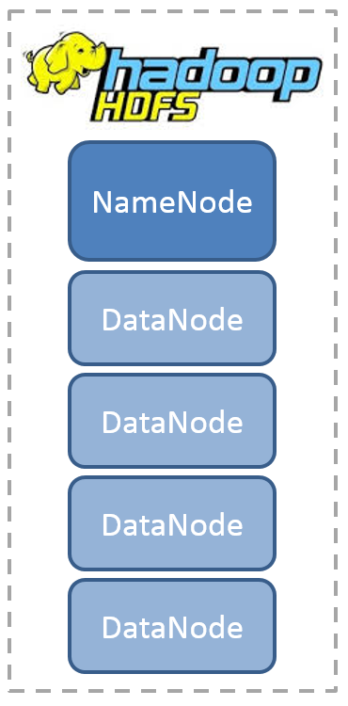
Typical system based on Hadoop ecosystem
1a. Reprocess the data
2. Analytic processing
2b. Low latency store
Shell/Notebook
2a. Visualize
DATA SOURCE
1. Data Ingestion
Graphical UI
3. Publish

Slide 25
Data processing on Hadoop

Slide 26
MapReduce – the first data processor on Hadoop
It is the first batch data processing framework for Hadoop
A programing model for parallel processing of a distributed data
Executes in parallel user’s Java code
2 stages: Map and Reduce
Optimized on local data access
MapReduce
YARN
Cluster resource manager
HDFS
Hadoop Distributed File System

Slide 27
Data processing with MapReduce
Node 1
Node 2
Node 3
Node 4
Node 5
Node X
Data Slice 1
Data Slice 2
Data Slice 3
Data Slice 4
Data Slice 5
Data Slice X
- Extraction
- Filtering
- Transformation
Mapping
Data processor
Data processor
Data processor
Data processor
Data processor
Data processor
Data shuffling
- Grouping
- Aggregating
- Dissmising
Reducing
Data collector
Data collector
Result

Slide 28
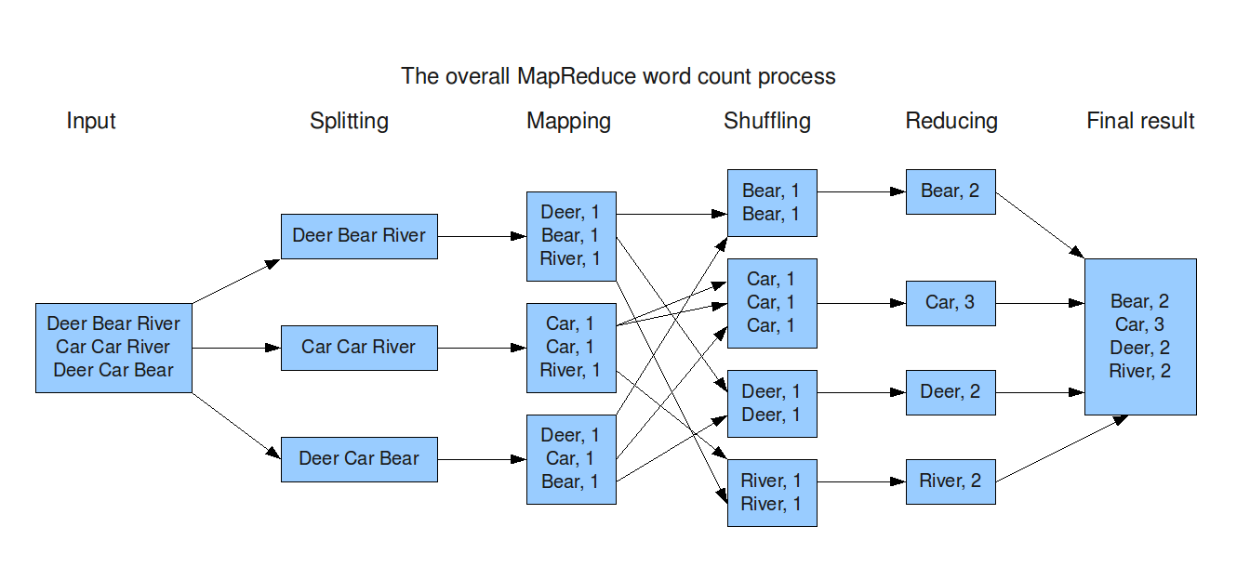
Example: The famous „world counting”

Slide 29
MR example
Counting certain specific rows in the collection
Oracle version
MapReduce
select /*+ parallel(x) */ count(*)
from my_table
where col93>100000 and col20=1;
//MAP method body
LongWritable one = new LongWritable(1);
NullWritable nw = NullWritable.get();
String[] records = line.split(',');
tight = Integer.parseInt(records[19]);
pt = Float.parseFloat(records[92]);
if (tight==1 && pt>100000)
{
collector.collect(nw,one);
}
//REDUCER method body
long sum = 0;
while (values.hasNext()) {
sum += values.next().get();
}
output.collect(NullWritable.get(),
new LongWritable(sum));

Slide 30
Demo
The problem
Q: „What happens after two rainy days in the Geneva region?”
A: „Monday”
The goal
Proof if the theory is true or false with MapReduce
Solution
Build a histogram of days of a week preceded by 2 or more bad weather days based on meteo data for GVA
?
days count
Mon | Tue |Wed |Thu | Fr | Sat | Sun

Slide 31
Demo
The source data (http://rp5.co.uk)
Source: Last 5 years of weather data taken at GVA airport
CSV format
What is a bad weather day?:
Weather anomalies (col nr 11) between 8am and 10pm
"Local time in Geneva (airport)";"T";"P0";"P";"U";"DD";"Ff";"ff10";"WW";"W'W'";"c";"VV";"Td";
"06.06.2015 00:50";"18.0";"730.4";"767.3";"100";"variable wind direction";"2";"";"";"";"No Significant Clouds";"10.0 and more";"18.0";
"06.06.2015 00:20";"18.0";"730.4";"767.3";"94";"variable wind direction";"1";"";"";"";"Few clouds (10-30%) 300 m, scattered clouds (40-50%) 3300 m";"10.0 and more";"17.0";
"05.06.2015 23:50";"19.0";"730.5";"767.3";"88";"Wind blowing from the west";"2";"";"";"";"Few clouds (10-30%) 300 m, broken clouds (60-90%) 5400 m";"10.0 and more";"17.0";
"05.06.2015 23:20";"19.0";"729.9";"766.6";"83";"Wind blowing from the south-east";"4";"";"";"";"Few clouds (10-30%) 300 m, scattered clouds (40-50%) 2400 m, overcast (100%) 4500 m";"10.0 and more";"16.0";
"05.06.2015 22:50";"19.0";"729.9";"766.6";"94";"Wind blowing from the east-northeast";"5";"";"Light shower(s), rain";"";"Few clouds (10-30%) 1800 m, scattered clouds (40-50%) 2400 m, broken clouds (60-90%) 3000 m";"10.0 and more";"18.0";
"05.06.2015 22:20";"20.0";"730.7";"767.3";"88";"Wind blowing from the north-west";"2";"";"Light shower(s), rain, in the vicinity thunderstorm";"";"Few clouds (10-30%) 1800 m, cumulonimbus clouds , broken clouds (60-90%) 2400 m";"10.0 and more";"18.0";
"05.06.2015 21:50";"22.0";"730.2";"766.6";"73";"Wind blowing from the south";"7";"";"Thunderstorm";"";"Few clouds (10-30%) 1800 m, cumulonimbus clouds , scattered clouds (40-50%) 2100 m, broken clouds (60-90%) 3000 m";"10.0 and more";"17.0";
"05.06.2015 21:20";"23.0";"729.6";"765.8";"78";"Wind blowing from the west-southwest";"4";"";"Light shower(s), rain, in the vicinity thunderstorm";"";"Few clouds (10-30%) 1740 m, cumulonimbus clouds , scattered clouds (40-50%) 2100 m, broken clouds (60-90%) 3000 m";"10.0 and more";"19.0";
"05.06.2015 20:50";"23.0";"728.8";"765.0";"65";"variable wind direction";"2";"";"In the vicinity thunderstorm";"";"Scattered clouds (40-50%) 1950 m, cumulonimbus clouds , scattered clouds (40-50%) 2100 m, broken clouds (60-90%) 3300 m";"10.0 and more";"16.0";
"05.06.2015 20:20";"23.0";"728.2";"764.3";"74";"Wind blowing from the west-northwest";"4";"";"Light thunderstorm, rain";"";"Scattered clouds (40-50%) 1950 m, cumulonimbus clouds , scattered clouds (40-50%) 2100 m, broken clouds (60-90%) 3300 m";"10.0 and more";"18.0";
"05.06.2015 19:50";"28.0";"728.0";"763.5";"45";"Wind blowing from the south-west";"5";"11";"Thunderstorm";"";"Scattered clouds (40-50%) 1950 m, cumulonimbus clouds , scattered clouds (40-50%) 2100 m, broken clouds (60-90%) 6300 m";"10.0 and more";"15.0";
"05.06.2015 19:20";"28.0";"728.0";"763.5";"42";"Wind blowing from the north-northeast";"2";"";"In the vicinity thunderstorm";"";"Few clouds (10-30%) 1950 m, cumulonimbus clouds , broken clouds (60-90%) 6300 m";"10.0 and more";"14.0";

Slide 32
Demo – MapReduce flow
Input Data:
Record: Weather report every hour
"06.06.2015 00:50";"18.0";
"06.06.2015 00:20";"18.0";
"05.06.2015 23:50";"19.0";
"05.06.2015 23:20";"19.0";
"05.06.2015 22:50";"19.0";
"05.06.2015 22:20";"20.0";
"05.06.2015 21:50";"22.0";
"05.06.2015 21:20";"23.0";
"05.06.2015 20:50";"23.0";
"05.06.2015 20:20";"23.0";
"05.06.2015 19:50";"28.0";
"05.06.2015 19:20";"28.0";
"06.06.2015 00:50";"18.0";
"06.06.2015 00:20";"18.0";
"05.06.2015 23:50";"19.0";
"05.06.2015 23:20";"19.0";
"05.06.2015 22:50";"19.0";
"05.06.2015 22:20";"20.0";
"05.06.2015 21:50";"22.0";
"05.06.2015 21:20";"23.0";
"05.06.2015 20:50";"23.0";
"05.06.2015 20:20";"23.0";
"05.06.2015 19:50";"28.0";
"05.06.2015 19:20";"28.0";
"06.06.2015 00:50";"18.0";
"06.06.2015 00:20";"18.0";
"05.06.2015 23:50";"19.0";
"05.06.2015 23:20";"19.0";
"05.06.2015 22:50";"19.0";
"05.06.2015 22:20";"20.0";
"05.06.2015 21:50";"22.0";
"05.06.2015 21:20";"23.0";
"05.06.2015 20:50";"23.0";
"05.06.2015 20:20";"23.0";
"05.06.2015 19:50";"28.0";
"05.06.2015 19:20";"28.0";
"06.06.2015 00:50";"18.0";
"06.06.2015 00:20";"18.0";
"05.06.2015 23:50";"19.0";
"05.06.2015 23:20";"19.0";
"05.06.2015 22:50";"19.0";
"05.06.2015 22:20";"20.0";
"05.06.2015 21:50";"22.0";
"05.06.2015 21:20";"23.0";
"05.06.2015 20:50";"23.0";
"05.06.2015 20:20";"23.0";
"05.06.2015 19:50";"28.0";
"05.06.2015 19:20";"28.0";
"06.06.2015 00:50";"18.0";
"06.06.2015 00:20";"18.0";
"05.06.2015 23:50";"19.0";
"05.06.2015 23:20";"19.0";
"05.06.2015 22:50";"19.0";
"05.06.2015 22:20";"20.0";
"05.06.2015 21:50";"22.0";
"05.06.2015 21:20";"23.0";
"05.06.2015 20:50";"23.0";
"05.06.2015 20:20";"23.0";
"05.06.2015 19:50";"28.0";
"05.06.2015 19:20";"28.0";
"05.06.2015 19:20";"28.0";
"05.06.2015 19:20";"28.0";
"05.06.2015 19:20";"28.0";
"05.06.2015 19:20";"28.0";
"05.06.2015 19:20";"28.0";
"05.06.2015 19:20";"28.0";
"05.06.2015 19:20";"28.0";
"05.06.2015 19:20";"28.0";
"05.06.2015 19:20";"28.0";
"05.06.2015 19:20";"28.0";
"05.06.2015 19:20";"28.0";
"05.06.2015 19:20";"28.0";
"05.06.2015 19:20";"28.0";
"05.06.2015 19:20";"28.0";
"05.06.2015 19:20";"28.0";
"05.06.2015 19:20";"28.0";
"05.06.2015 19:20";"28.0";
"05.06.2015 19:20";"28.0";
"05.06.2015 19:20";"28.0";
"05.06.2015 19:20";"28.0";
Code:
https://gitlab.cern.ch/db/hadoop-intro/tree/master/MapReduce
1st MR job
Reduced data:
Record: Dates with good weather preceded by
two or more days with bad weather
2016.09.11 0
2016.09.12 0
2016.09.13 0
2016.09.20 6
2016.09.26 5
2016.09.30 3
2016.10.04 3
2016.10.05 0
2016.10.06 0
2016.10.07 0
2016.10.10 2
2016.10.12 1
2016.10.15 2
2016.10.20 4
2016.10.21 0
2016.10.22 0
2016.10.27 4
Reduced data:
Record: Day of a week with counter of occurrences
Monday 32
Tuesday 0
Wednesday 3
Thursday 10
Friday 20
Saturday 23
Sunday 25
2nd MR job

Slide 33
Limitations of MapReduce
Not interactive
Process of scheduling job takes significant amount of time
Negotiation with YARN, sending client code, application master has to setup (start JVM, etc.)
Typically separate executor (data processor) for each data unit (e.g. HDFS block)
A lot of executors has to be started (JVM and local environment has to be setup) , short life-time
Complex processing requires to lunch multiple MR jobs
Only 2 stages per job
Intermediate results has to be dump to HDFS <- takes time
Each data processing task has to be implemented by a user
Time consuming process especially for data exploration cases

Slide 34
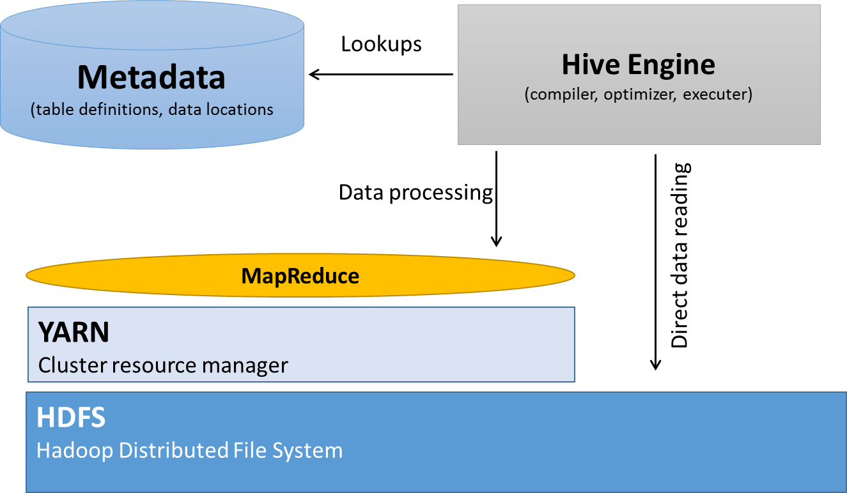
Apache Hive for SQL with MR
Data warehousing layer on top of Hadoop
table abstractions and query language
SQL-like language (HiveQL) for “batch” data processing
SQL is translated into one or series of MapReduce jobs
No need to write and compile Java code
Good for ad-hoc reporting queries on HDFS data
however generated MR executions can be sub optimal

Slide 35
Hive in practice
3 steps
Create your own Hive database – container for tables
Define a table(s) on top of your HDFS data
Run queries on tables
Tables can be partitioned (each partition is a single HDFS directory)
Many file formats supported
Interfaces
command line interface
JDBC and ODBC drivers
Thrift API

Slide 36
Hive SQL
Geneva Weather case in SQL:
Full example: https://gitlab.cern.ch/db/hadoop-intro/tree/master/Hive
with source as (select from_unixtime(unix_timestamp(time,'dd.MM.yyyy HH:mm')) time,weather from geneva_weather where time is not null),
weather as (select time,case when weather in ('',' ') then 0 else 1 end bad_wather from source where hour(time) between 8 and 20 ),
bad_days as (select from_unixtime(unix_timestamp(time),'yyyy-MM-dd') as time, sum(bad_wather) bad from weather group by from_unixtime(unix_timestamp(time),'yyyy-MM-dd')),
checked as (select time,bad,lag(bad,1) over (order by time) bad1, lag(bad,2) over (order by time) bad2 from bad_days)
select from_unixtime(unix_timestamp(time,'yyyy-MM-dd'),'u') ,count(*) from checked where bad=0 and bad1>0 and bad2>0 group by from_unixtime(unix_timestamp(time,'yyyy-MM-dd'),'u') ;

Slide 37
Apache Pig for scripted MR
Same purpose like Hive -> no low-level MR coding with Java
translated into a series of MapReduce jobs
High level scripting language “Pig Latin” instead of pure SQL
Procedural data flow oriented
For structured and unstructured data (schema on read)

Slide 38
Pig Script
WEATHER = load 'data/GVA_data.csv' using PigStorage(';') as
(
time:chararray,
temperature:float,
pressure:float,
pressure_reduced:float,
pressure_tendency:float,
humidity:int,
wind_direction:chararray,
wind_speed:chararray,
wind_gust_max_value1:chararray,
wind_gust_max_value2:chararray,
total_cloud_cover:chararray,
weather:chararray,
past_weather1:chararray,
past_weather2:chararray,
min_past_temperature1:float,
min_past_temperature2:float,
clouds:chararray,
amount_of_clouds:chararray,
high_of_clouds_base:chararray,
clouds1:chararray,
clouds2:chararray,
visibility:chararray,
dewpoint_temperature:chararray,
amount_of_participation:chararray,
participation_period:chararray,
snow_state:chararray,
min_surface_temp:float,
state_of_ground:chararray,
snow_deph:int
);
NARROW = foreach WEATHER generate REPLACE(time,'\\"', '') as time,REPLACE(weather,'\\"', '') as weather;
NARROW_FILTERED = filter NARROW by (weather!='WW' and GetHour(ToDate(time, 'dd.MM.yyyy HH:mm','UTC'))>=7 and GetHour(ToDate(time, 'dd.MM.yyyy HH:mm','UTC'))<=18);
BAD_WEATHER = foreach NARROW_FILTERED generate ToString(ToDate(time, 'dd.MM.yyyy HH:mm','UTC'), 'yyyy-MM-dd') as date ,weather,(weather==' '? 0 : 1) as (state:int);
GROUP_DATES = group BAD_WEATHER by date;
DATES = foreach GROUP_DATES generate group as date,SUM(BAD_WEATHER.state) as bad_weather;
RD = RANK DATES;
STORE RD INTO 'pig_tmp' USING PigStorage (',');
RD0 = load 'pig_tmp' USING PigStorage (',') as (rank_DATES: long,date: chararray,bad_weather: long);
RD1 = FOREACH RD0 generate rank_DATES + (long)1 as (rank_DATES:long),bad_weather;
RD2 = FOREACH RD0 generate rank_DATES + (long)2 as (rank_DATES:long),bad_weather;
JOINED = JOIN RD0 BY rank_DATES, RD1 BY rank_DATES,RD2 BY rank_DATES;
INTERESTING = filter JOINED BY (RD0::bad_weather==0 and RD1::bad_weather>0 and RD2::bad_weather>0);
DAYS = foreach INTERESTING generate (DaysBetween(ToDate(RD0::date,'yyyy-MM-dd'),ToDate(0L)) + 4L) % 7 as day;
GROUPED_DAYS = group DAYS by day;
FINAL = foreach GROUPED_DAYS generate group as day_of_week, COUNT(DAYS.day) as count;
dump FINAL;
Full example https://gitlab.cern.ch/db/hadoop-intro/tree/master/Pig

Slide 39
Limitation of MapReduce
Not interactive
Process of scheduling job takes significant amount of time
Negotiation with YARN, sending client code, application master has to setup (start JVM, etc.)
Typically separate executor (data processor) for each data unit (e.g. HDFS block)
A lot of executors has to be started (JVM and local environment has to be setup) , short life-time
Complex processing requires to lunch multiple MR jobs
Only 2 stages per job
Intermediate results has to be dump to HDFS <- takes time
Each data processing task has to be implemented by a user
Time consuming process especially for data exploration cases

Slide 40
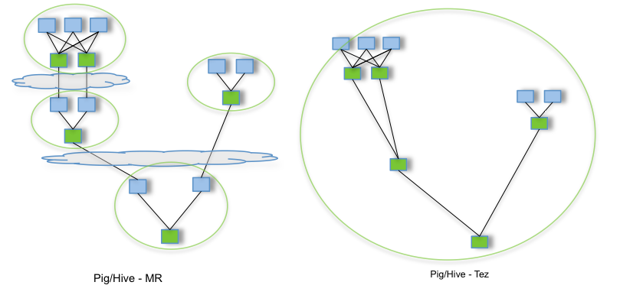
Apache Tez – for accelerating Hive and Pig
Allows complex directed-acyclic-graph of tasks for processing data
Performance gains over Map Reduce by keeping data in memory
Plan reconfiguration at runtime
Popular in Hortonworks distribution

Slide 41

Limitation of MapReduce
Not interactive
Process of scheduling job takes significant amount of time
Negotiation with YARN, sending client code, application master has to setup (start JVM, etc.)
Typically separate executor (data processor) for each data unit (e.g. HDFS block)
A lot of executors has to be started (JVM and local environment has to be setup) , short life-time
Complex processing requires to lunch multiple MR jobs
Only 2 stages per job
Intermediate results has to be dump to HDFS <- takes time
Each data processing task has to be implemented by a user
Time consuming process especially for data exploration cases

Slide 42

Apache Impala
MPP SQL query engine running on Apache Hadoop
Input data stored on HDFS , Apache HBase, S3 and Apache Kudu
Low latency SQL queries (query start up time ~100ms)
Typically much faster than Hive
executing demons are up all the time
C++, no Java JVMs, no GC
by default does not use YARN
Client
SQL
Result
Query Planner
Query Planner
Query Planner
Query Coordinator
Query Coordinator
Query Coordinator
Query Executor
Query Executor
Query Executor
HDFS
HDFS
HDFS
More about Impala and Hive: https://indico.cern.ch/event/434650/

Slide 43
Apache Impala in practice
Is like Hive (it uses Hive metastore to keep tables definitions)
Map data
Run a query
Interfaces
impala-shell
Hue for result visualisation
Thrift, JDBC or ODBC for applications

Slide 44
Impala SQL
with source_cleaned as (select regexp_replace(time,'"','') time ,regexp_replace(weather,'"','') weather from geneva_weather),
interesting_data as (select cast(unix_timestamp(time,'dd.MM.yyyy HH:mm') as timestamp) time,weather from source_cleaned where time is not null),
weather as (select time,case when weather in ('',' ') then 0 else 1 end bad_wather from interesting_data where extract (hour from time) between 8 and 20 ),
bad_days as (select trunc(time,'dd') as time, sum(bad_wather) bad from weather group by time),
checked as (select time,bad,lag(bad,1) over (order by time) bad1, lag(bad,2) over (order by time) bad2 from bad_days)
select dayname(time) day,count(*) from checked where bad=0 and bad1>0 and bad2>0 group by day
;
Full example: https://gitlab.cern.ch/db/hadoop-intro/tree/master/Impala

Slide 45


Criticism of MapReduce
Not interactive
Process of scheduling job takes significant amount of time
Negotiation with YARN, sending client code, application master has to setup (start JVM, etc.)
Typically separate executor (data processor) for each data unit (e.g. HDFS block)
A lot of executors has to be started (JVM and local environment has to be setup) , short life-time
Complex processing requires to lunch multiple MR jobs
Only 2 stages per job
Intermediate results has to be dump to HDFS <- takes time
Each data processing task has to be implemented by a user
Time consuming process especially for data exploration cases

Slide 46
Apache Spark – the next generation MapReduce
A framework for performing distributed computations
Scalable, applicable for processing TBs of data
Easy programming interface
Supports Java, Scala, Python, R
Multiple language supported: Java, Scala, Python, R and SQL
Optimized for complex processing
Allows complex directed-acyclic-graph of tasks
Staged data kept in memory
Long living executors – processing multiple tasks
Varied APIs: DataFrames, SQL, MLib, Streaming
Multiple cluster deployment modes – including Hadoop
Multiple data sources: HDFS, HBase, S3, Kudu, JDBC, Cassandra….

Slide 47
Spark - Driver, executor
cluster
import scala.math.random
val slices = 3
val n = 100000 * slices
val rdd = sc.parallelize(1 to n, slices)
val sample = rdd.map { i =>
val x = random
val y = random
if (x*x + y*y < 1) 1 else 0
}
val count = sample.reduce(_ + _)
println("Pi is roughly " + 4.0 * count / n)
Machine1
Executor
Driver
Machine2
Cluster Managers
SparkContext
Executor
Machine3
Executor

Slide 48
Spark – SQL query example (v2.2.0)
#defining dataframe with schema from parquet files
val df = spark.read.parquet("/user/zbaranow/datasets/")
#counting the number of pre-filtered rows with DF API
df.filter($"l1trigchainstap".contains("L1_TAU4")).count
#counting the number of pre-filtered rows with SQL
df.registerTempTable("my_table")
spark.sql("SELECT count(*) FROM my_table where l1trigchainstap like '%L1_TAU40%'").show

Slide 49
When to use what? (based on our experience)
MapReduce
do not code your jobs – it is time consuming, however can be more efficient than Pig or Hive
only if other tools use it (like Sqoop)
Pig
A bit out-dated => use Apache Spark instead (more efficient, more features)
Hive
For mapping data into table structures
For processing tables use Impala or SparkSQL for high performance
Impala
For interactive data access (low latency queries).
Reports from big datasets.
For complex analytics with multiple joins Spark would be better.
Spark
Cover most of use cases except low latency queries.

Slide 50
Data formats for HDFS

Slide 51
Data format on HDFS is important
In big data world we deformalize the data
Because joins are expensive
Duplication is not a problem – storage is cheap
Modern file formats/encodings can avoid reading unnecessary data anyway thanks to physical data layout, partitioning and statistics
Benefits from choosing the right format
Decrease data volume
Increase data access speed
Reduce the amount of resources needed for data processing
How to achieve this?
Encoding and compression
Partitioning
Typical HDFS data formats
Natural: Text-log, CSV, JSON
Specialized: Apache Avro, Apache Parquet
Hadoop NoSQL database: Apache HBase, Apache Kudu
Typical compression
Snappy
Bzip2/Gzip

Slide 52
Data partitioning in HDFS directories (horizontal)
Group data by certain attribute(s) in separate HDFS directories
Will reduce amount of data to be read
Aug 2013
/user/zaza/mydata/Aug2013/data
Dec 2014
/user/zaza/mydata/Dec2014/data
Feb 2015
/user/zaza/mydata/Dec2015/data

Slide 53

Apache Avro data file
Fast, binary serialization format for structured data
Internal schema with multiple data types including nested ones
scalars, arrays, maps, structs, etc
Schema in JSON
Record {a=27, b=‘foo’}
Encoded (hex): 36 06 66 6f 6f
{
"type": "record",
"name": "test",
"fields" : [
{"name": "a", "type": "long"},
{"name": "b", "type": "string"}
]
}
long – variable-length zigzag
String length
String chars

Slide 54
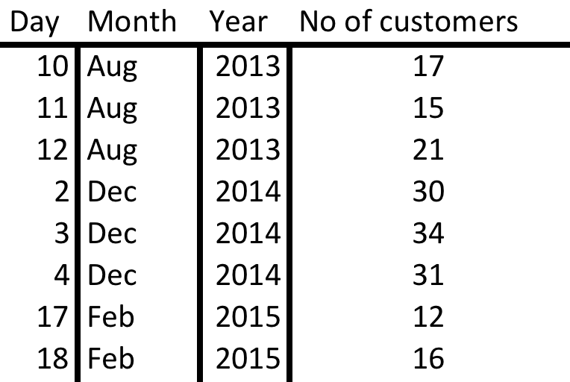
Columnar store for analytics
We are interested in reading certain columns
But in traditional row-stores we are always reading entire row data
Columnar store
Col1
Col2
Col3
Col4

Slide 55

Apache Parquet – a columnar storage for HDFS
Based on Google “Dremel”
Internal schema with multiple data types including nested ones
Multiple encoding applicable on per column-bases
RLE, Dictionary, Delta, Bit packing
Chosen automatically
Column-level statistics per each block/rowgroup
Compressions supported
Snappy, gzip, LZO
Block
Block
Block
Block
Footer
Column 1 chunk
Column 2 chunk
Column 3 chunk
Page
Page
Page
Page

Slide 56
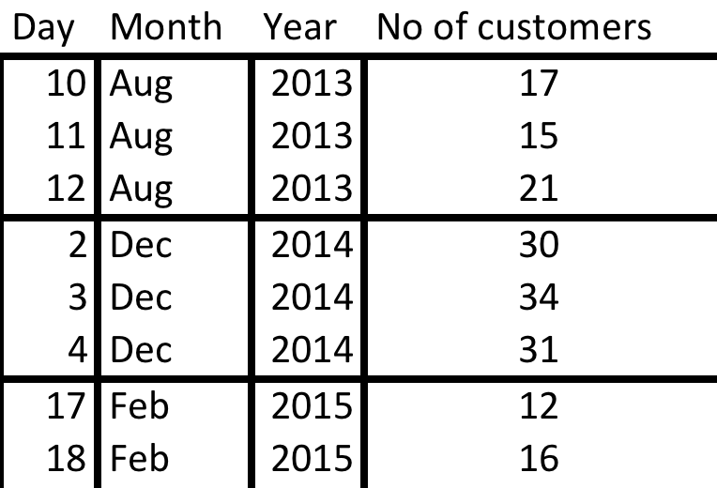
Slicing and dicing
Horizontal and vertical partitioning – for efficient data processing
Col1
Col2
Col3
Col4
Col1
Col2
Col3
Col4
Col1
Col2
Col3
Col4

Slide 57
HBase in a nutshell
HBase is a key-value store on top of HDFS
horizontal (regions) + vertical (col. families) partitioning
row key values are indexed within regions
data typefree – data stored in bytes arrays
Fast random data access by key
Stored data can be modified (updated, deleted)
Has multiple bindings
SQL (Impala/Hive, Phoenix), Java, Python
Good for massive concurrent random data access
..but not good for big data sequential processing!

Slide 58
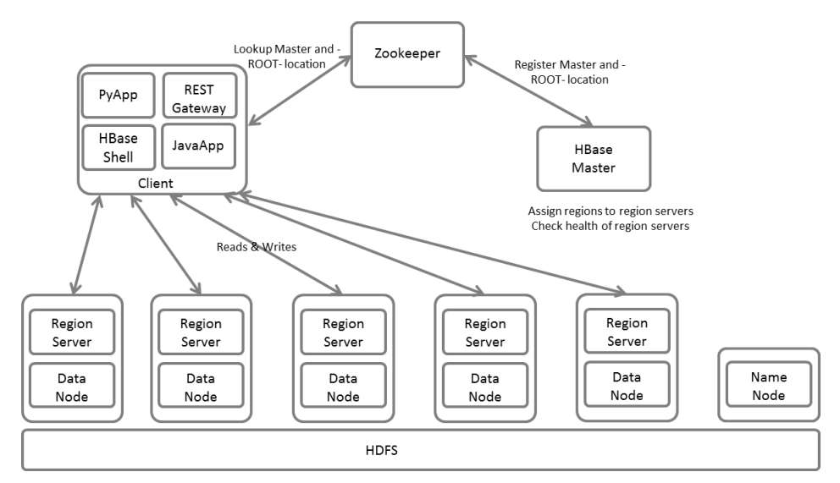
HBase: master-slaves architecture
HBase master
assigns table regions/partitions to region servers
maintains metadata and table schemas
HBase region servers
servers clients requests (reading and writing)
maintain and store the region data on HDFS
writes WAL in order to recover the data after a failure
performs region splitting when needed

Slide 59
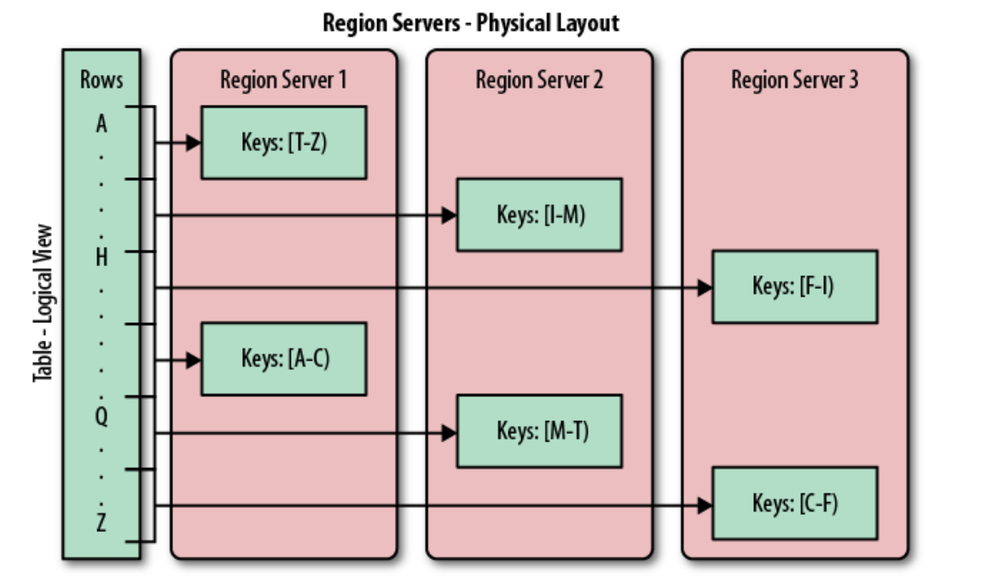
HBase table data organisation
More about HBase: https://indico.cern.ch/event/439742/

Slide 60
HBase - operations
With ‘hbase shell’
create 'data','cf1' # create table with one column family ‘cf1’
put 'data','row1','cf1:col1','hello' # inserting a value for a column
put 'data','row1','cf1:col2','hi' # inserting a value for a column
get 'data','row1' # getting row1 values
scan 'data' # scanning table fully
scan 'data',{STARTROW=>'row0',STOPROW=>'row5'} #range scan
disable 'data' # disabling table
drop 'data' # dropping a table

Slide 61

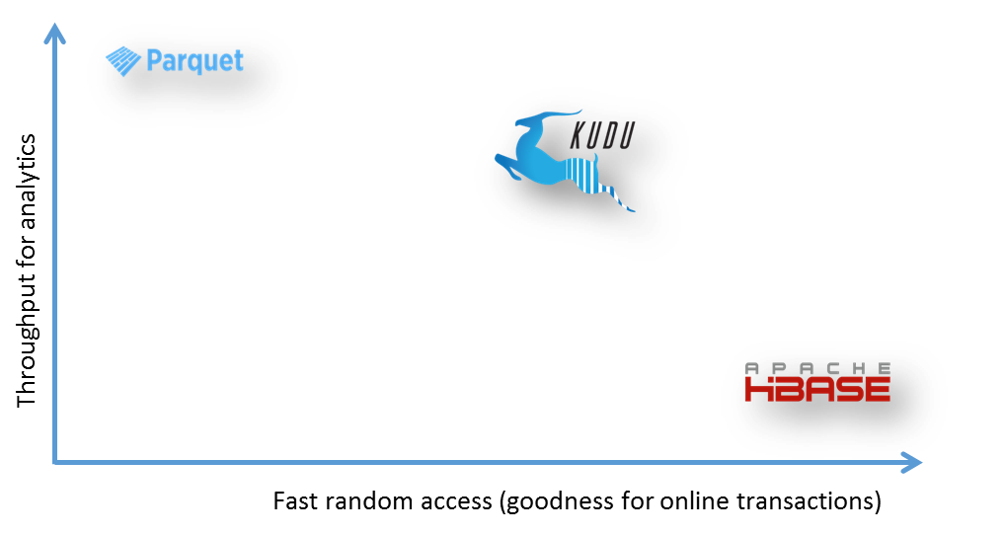
Apache Kudu – next generation HBase
Distributed storage for structured data (tables)
Indexing (on PK like HBase and Cassandra)
Columnar store (like Parquet or ORC)
Fast data lookups by PK
Fast scans on columns
Mutable (insert, update, delete)
Written in C++
Independent from Hadoop
No HDFS, nor YARN required
Supports many language bindings and frameworks
C++, Java, Python, MapReduce, Impala, Spark, Flume…

Slide 62
Kudu is a table-oriented storage
A Kudu table has a fixed schema (similar to RDBMS)
Primary key (one or many columns),
NO secondary indexes
Finite number of columns (unlike HBase)
Each column has
Name, type, encoding and compression type (like Parquet)
Tables are horizontally partitioned (range, hash)
Each partition can have 3, 5 or 7 replicas

Slide 63

Tables and tablets in Kudu
Map of table TEST:
Kudu Master
Consistency – data with one leader
Partition resilient – more than one copy of data (Raft)
Kudu Master
TabletID | Leader | Follower1 | Follower2
TEST1 | TS1 | TS2 | TS3
TEST2 | TS4 | TS1 | TS2
TEST3 | TS3 | TS4 | TS1
Kudu Master
TabletID | Leader | Follower1 | Follower2
TEST1 | TS1 | TS2 | TS3
TEST2 | TS4 | TS1 | TS2
TEST3 | TS3 | TS4 | TS1
Partition | Leader | Follower1 | Follower2
TEST1 | TS1 | TS2 | TS3
TEST2 | TS4 | TS1 | TS2
TEST3 | TS3 | TS4 | TS1
Lookup TEST
Write to TEST1
TabletServer1
TabletServer2
TabletServer3
TabletServer4
Leader TEST1
Replicate
Follower TEST1
Follower TEST1
Leader TEST2
Replicate
Follower
TEST2
Follower
TEST2
Leader TEST3
Follower
TEST3
Follower
TEST3

Slide 64
When to use what? (based on our experience)
JSON, CSV
universal formats (each tool can process them)
not optimal for analytics at scale -> slow scan speed
keep always compressed to save space and increase performance
Avro
fastest data encoding or decoding
good for data transferring, staging etc.
not as efficient as Parquet for analytics (when few columns attributes of a record are accessed)
Parquet
Very good for analytics
Slower than Avro when all data (all attributes) have to be processed
HBase
Fast for random data lookups by key; data updating is possible; unstructured data
Inefficient for analytics (slow data scans)
Kudu
Fast for random data lookups by key; data updating is possible; structured data
Efficient for analytics
Snappy compression
Good compromise between space reduction (5x for text) and performance

Slide 65
Data ingestion to Hadoop

Slide 66




What are the challenges?
Variety of data sources
Databases
Web
REST
Logs
Whatever…
Not all of them are necessary producing files…
HDFS is a file system, not a database
You need to store files
Extraction-Tranformation-Loading tools needed
Streaming data
Files in batch

Slide 67
Data ingestion types
Batch ingestion
Data are already produced and available to store on Hadoop (archive logs, files produced by external systems, RDBMS)
Typically big chunks of data
Real time ingestion
Data are continuously produced
Streaming sources

Slide 68
Batch ingestion
hdfs dfs –put or HDFS API
sends file from local system to HDFS
file is sent sequentially
Custom programs with using HDFS API
Kite SDK
sends (text) files and encodes in Avro, Parquet or store in HBase
multithreaded
Apache Sqoop – loading data from external relational databases
Apache Spark – general purpose

Slide 69

About Kite
High level data API for Hadoop
Java API
Command line inteface
Two steps to store your structured data
Create dataset - configure how to store the data
Data schema, partitioning strategy
File format: JSON, Parquet, Avro, HBase
dataset metadata: on HDFS or in Hive (as a table)
Import the data
From local file system, or HDFS

Slide 70
KiteSDK – Hand-on
Loading a CSV data to HDFS into parquet format
1) infer schema from the data (ratings.csv)
2) create data partitioning policy (optional)
3) create a datastore on HDFS
4) load the data
$ kite-dataset csv-schema ratings.csv --record-name ratings -o ratings.avsc
$ echo “[
{"type": "year", "source": "timestamp"}
]”>> partition.policy.json
$ kite-dataset create dataset:hdfs:/user/zbaranow/datasets/ratings –schema \ ratings.avsc --format parquet --partition-by partition.policy.json
$ kite-dataset csv-import ratings.csv --delimiter ',' \
dataset:hdfs:/user/zbaranow/datasets/ratings

Slide 71
About Apache Sqoop
Tool to transfer data (snapshots) between structured databases and Hadoop
Sqoop tasks are implemented as map reduce jobs – can scale on the cluster
Database
(MySQL, Oracle, PostgreSQL, DB2
HDFS
(Files, Hive, HBase)
Sqoop Import
JDBC
Sqoop Export

Slide 72
Tips for Sqoop
For big data exports (>1G) use dedicated connectors for target database
Logic that understand how to read data efficiently from target db system
By default it will run “select * from source_table”
Do not use too many mappers/sessions
Excessive number of concurrent sessions can kill a database
max 10 mappers/sessions
Remember: Sqoop does not retransfer (automatically) updated data

Slide 73
How to run a Sqoop job
Example (target Oracle):
sqoop import \ #impoting from DB to HDFS
--direct
--connect jdbc:oracle:thin:@itrac5110:10121/PIMT_RAC51.cern.ch \
--username meetup \ #database user
--table meetup_data #table name to be imported
-P \
--num-mappers 2 \ #number of parallel sessions
--target-dir meetup_data_sqooop \ #target HDFS directory

Slide 74
Integrating Oracle and Hadoop (hybrid system)
Step1: Offload data to Hadoop
Step2: Offload analytic queries to Hadoop
Oracle database
Hadoop cluster
Table partitions import
Apache Sqoop
Data formats: Parquet, Avro
Max ~20k rows/s limit
SQL
ODBC
gateway
Oracle database
Offloaded SQL
Hadoop cluster
Offload interface: DB LINK, External table
SQL engines: Hive, Impala

Slide 75
‘Real-time’ ingestion to Hadoop
Real-time means with low latency
More challenging than batch ingestion
It is a continues process
if it stops some data can be lost
data streams has to be materialized in HDFS files
There is always a latency when storing to HDFS
creating a file per a stream event will kill HDFS
events has to be written in batches after all

Slide 76
What are the challenges ?
Hadoop works efficiently with big files
(> a block size=128MB)
placing big data in small files will degrade processing performance (typically one worker per file)
and reduce hdfs capacity
NameNode fs image memory available = 20GB
File meta size = ~125B
Directory meta size = ~155B
Block meta size = ~184B

Slide 77
Solutions for low latency (1)
1) Writing files frequently to HDFS
Decreases data latency ☺
Creates many files ☹
2) Compacting them periodically
HDFS
Stream Source
Data Sink
File1
File2
File3
File4
File5
File6
File7
File8
File9
File10
File11
File12
File13
Events
HDFS
File1
File2
File3
File4
File5
File6
File7
File8
File9
File10
File11
File12
File13
Merge
Big File

Slide 78

Solutions for low latency (2)
1) Stage data into staging buffers
Making them immediately accessible to access
2) Flush buffers periodically to HDFS files
Requires two access path to the data (buffers + HDFS)
Stream Source
Data Sink
Staging area
Events
Flush
HDFS
Big File

Slide 79
Apache Flume – for shipping streaming data
Data transfer engine driven by events
Flume events (messages) consists of
Headers (for metadata)
Body (byte array)
Events can be
Filtered, Processed, Aggregated
Main features
Flexible topologies - agents can send data/event between each other
Pluggable – easily extendable
Reliable – uses transactions

Slide 80
Flume agent
Single Agents consists of:
A source
Files/Logs/Directories, Kafka, Twitter…STDOUT from a program
Custom source (reading from REST API)
Event interceptors (re-processors) can be implemented with Java
A channel for staging the data
Memory, File
Kafka
JDBC
…
Custom
A sink
HDFS, HBase, Kafka, ElasticSearch
….
Custom
flume-agent
Source
Sink
Channel

Slide 81


Flume data flow
Multiple agents can be deployed
On the same machine or in a distributed manner
flume-agent
Source
Sink
Consolidation/aggregation
Channel
flume-agent
flume-agent
Source
Sink
Source
Sink
Channel
Channel
flume-agent
Source
Sink
Channel

Slide 82
Flume demo
Flume Agent
htutorial-agent
Code: https://gitlab.cern.ch/db/hadoop-intro/tree/master/Flume/meetup_to_hdfs_and_kafka
HDFS
Memory
StrAPI
HBase
curl -s http://stream.meetup.com/2/rsvps
Memory

Slide 83
Is Apache Flume enough?
Yes, for simple use cases
Performance limited by a single machine
Consolidating multiple sources -> requires a lot of resources
Multiplexing of sinks -> duplicating data in channels
If HDFS in down for maintenance
Flume channel can be full quickly
It does not provide high availability
flume agent machine is a single point of failure
if it breaks we will lose data
Solution?
Stage data in a reliable distributed event broker
Apache Kafka

Slide 84
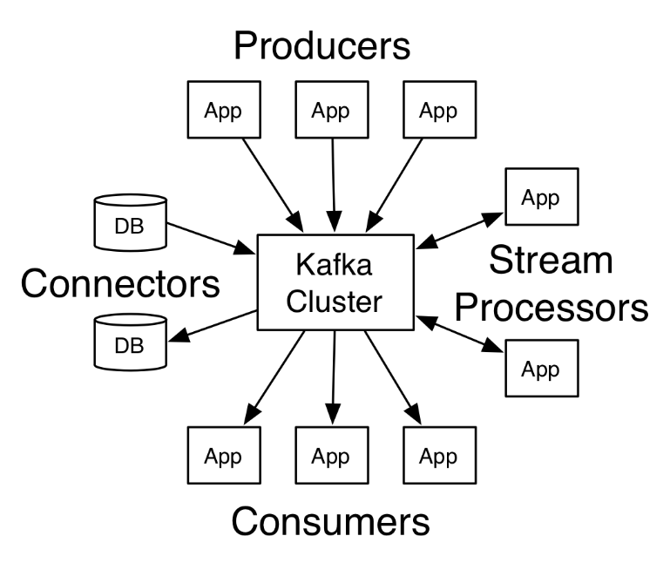
About Apache Kafka
Distributed streaming (messaging) platform
Open source project started at LinkedIn in 2011
Became an industry standard and important component of Hadoop ecosystem
Stores streams (messages) of data in distributed replicated cluster
Horizontally scalable (streams partitioning)
Fault tolerant (replication of partitions)
Allows to store, access and process the streams of data in real-time

Slide 85
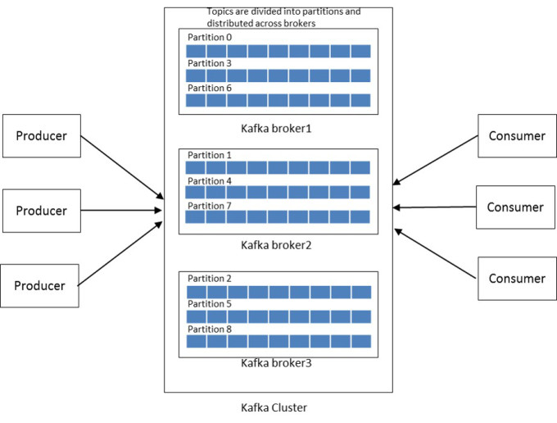
About Apache Kafka
Single stream is called “topic”
can have multiple writers
and readers
Topic is partitioned
partitions are distributed
and can be replicated
Durability of data within a stream
with configured retention
based on time or size
Available as centrally managed a service:
https://cern.service-now.com/service-portal/function.do?name=Kafka

Slide 86
Apache Kafka – how to use it
Custom implementation of producer and consumer using Kafka client API
Java, Scala, C++, Python
Kafka Connectors
LogFile, HDFS, JDBC, ElasticSearch…
Logstash
Source and sink
Apache Flume out-of-the-box can use Kafka as
Source, Channel, Sink
Other ingestion or processing tools support Kafka
Apache Spark, LinkedIn Gobblin, Apache Storm…

Slide 87






How Kafka can improve data ingestion
As reliable big staging area
Stream Source
Events
Staging area
Real time stream processing
Stream Source
Stream Source
Events
Stream Source
Events
Flush periodically
Flush immediately
HDFS
Indexed data
Big Files
Batch processing
Fast data access

Slide 88
Data ingestion and ETL - Spark
Example read from locafile store in parquet:
val df = spark.read
.format("csv")
.option("header", "true") //reading the headers
.option("mode", "DROPMALFORMED")
.load("file:///tmp/file.csv")
val df_1p = df.coalesce(1) #merge data into one partition/executor
df_1p.write.format("parquet").save("data.parquet")
Example read from Kafka:
val df = spark
.readStream
.format("kafka")
.option("kafka.bootstrap.servers", "host1:port1,host2:port2")
.option("subscribe", "topic1")
.load()
df.selectExpr("CAST(key AS STRING)", "CAST(value AS STRING)")
.as[(String, String)]
Example (source JDBC):
val data = spark.sql.read.format('jdbc').options(
url="jdbc:oracle:thin:@MYORADB/orcl.cern.ch",
user="myuser",
password="mypass",
dbtable="(select id, payload from my_oracle_table) df",
driver="oracle.jdbc.driver.OracleDriver"
).load()
data.write.format("parquet").save("hdfs://user/foo/mytable")

Slide 89
Data ingestion – when to use what?
Apache Sqoop
*
NameNode
+
DataNode
*
DataNode
+
Streaming data
DataNode
Remote copy
Pre-processing
DataNode
Files in batch
* when big volumes or extra processing needed

Slide 90
Quick Summary

Slide 91
Use the right technologies to optimize your business!
This storage technology decision tree is just for demonstration
Should not be used as a definitive guide
Online Transactional system?
Y
N
Expected system growth < 1GB/day?
Strong transaction semantics?
Structured data?
Y
N
Y
N
HDFS
HDFS + columnar file format
PostgreSQL, MySQL, Oracle
Structured data?
Analytics needed?
N
Y
Y
Frequent analytics needed?
HBase
Sqoop -> HDFS
N
Y
Cassandra
Kudu

Slide 92
Quick Summary
Hadoop is a framework for scalable data processing
Initially created for batch
Currently has storage solutions for serving interactive requests (like OLTP)
Consist of many components for different purposes
Try them out before starting to develop your custom tools
You do not have to be Java expert (though knowledge of Java is handy)
Evolving quite fast
MapReduce is obsolete
Currently Apache Spark has a lot of momentum
Many aspects to be addressed when designing a system on Hadoop
What type of ingest is needed (bulk load, stream ingestion..)
How to store the data to optimize further access
Partitioning, format (Parquet), compression
Data access pattern (interactive, batch…)
IT department provides Hadoop/Spark/Kafka services
https://cern.service-now.com/service-portal/function.do?name=Hadoop-Components
https://cern.service-now.com/service-portal/function.do?name=Kafka

